Slide 1
Advantages of using template apps in Power BI for data analytics
A Group 6 Presentation
GROW Cohort 2 Group 2

Slide 2
Outline
Apps in Power BI
Template Apps in Power BI
The Different Template Apps in Power BI
Uses of some Template Apps in Power BI
Advantages of using Template Apps in Power BI for data analytics
References

Slide 3
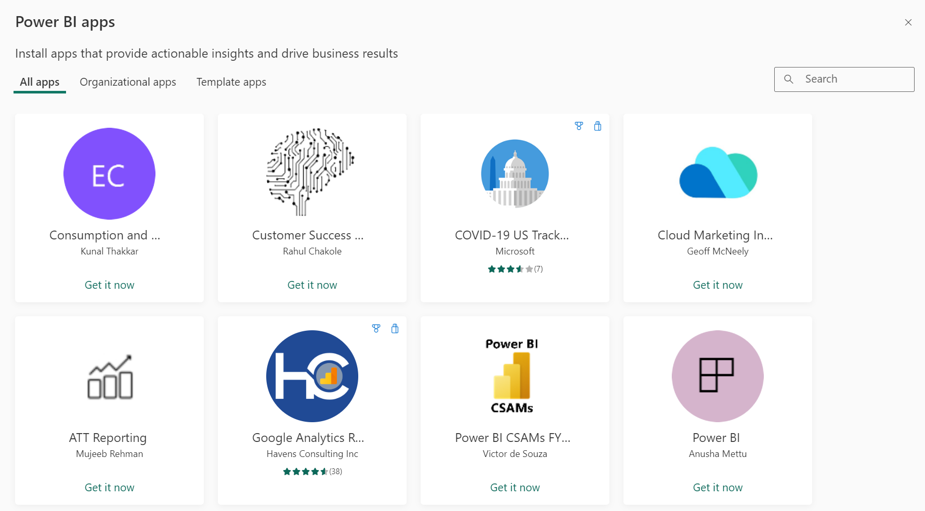
A Power BI App
This is an official packaged content, created by Power BI designers. The app is distributed to a broad audience.
A Power BI app combines related content, like dashboards, spreadsheets, semantic models, and reports, all in one place.
It has one or more of each content type bundled together.

Slide 4
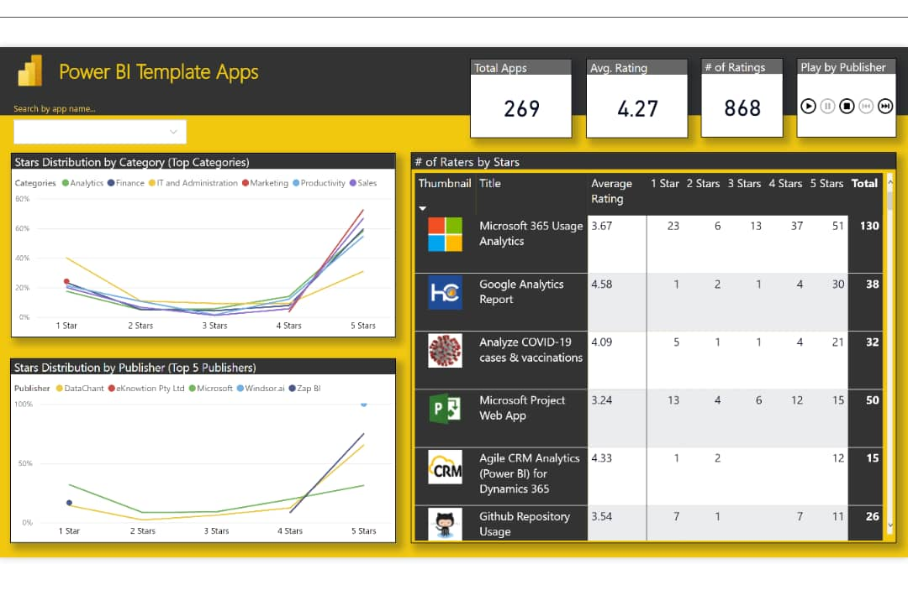
A Power BI Template App
This is a collection of pre-built dashboards and reports that can be easily customized and distributed.
Power BI template apps enable Power BI partners to build Power BI apps with little or no coding, and deploy them to any Power BI customer.
These template apps allow Power BI Pro or Power BI Premium users to gain immediate insights through prepackaged dashboards and reports that can be connected to live data sources.

Slide 5
The Different Template Apps in Power BI
Power BI Desktop Templates Files: Retail Analysis Templates, Financial Reporting Templates, Customer Analysis Templates, HR Analytics Templates, Healthcare Analytics Templates.
Power BI Service Apps: Microsoft Power Platform Analytics, Sales Force Analytics, Google Analytics, Microsoft Dynamic 365 Sales Analytics, Azure DevOps Analytics, GitHub Analytics.
Power BI Content Packs: Azure SQL Database Content Pack, MailChimp Content Pack, Dynamic 365 Content PackSales Templates.

Slide 6
Uses of Some Template Apps in Power BI
Power BI Desktop Templates Files - Retail Analysis Template Apps: These help in management decisions and the improvement of an organization's revenue.
Power BI Desktop Template Files - HR Analytics Template Apps: These include essential reports such as employee profile, headcount, and basic salary analysis.
Power BI Service Apps - Salesforce Analytics for Sales Managers template app: This provides insights for analyzing marketing effort. It provides key metrics, such as sales pipeline, best accounts, and KPIs.
Power BI Content Packs - MailChimp Content Pack template: This is used to explore data such as Top Campaigns of Total Opens by Day of Week.

Slide 7
Advantages of Template Apps in Power BI for data analysis
Consistency: By using a standardized template, one can ensure that all reports within the organization follow a consistent visual style and data organization. Also, consistency enhances the brand identity, improves readability, and reduces errors.
Time-saving: Template apps offer a pre-designed layout and data connections, significantly reducing the time required to build a new report or dashboard. Time-saving boosts decision-making as a result.
Faster Adoption: For new Power BI users, template apps provide a readily accessible starting point to quickly learn the platform and begin data analysis. This advantage increases productivity and encourages best practices in data analysis.

Slide 8
Thank you
Abena Tenewaa Omari
Lydia Fordjour
Perpetual Williams
Henry Kusodzi
Memunatu Alhassan
Raihana Ahmad

Slide 9
References
Microsoft Learn
What is a Power BI app?
What is a Power BI template app?
Uses of some template apps in Power BI
Uses of some template apps in Power BI
Microsoft AppSource
Uses of some template apps in Power BI
ExcelMojo
Advantages of using template apps in Power BI

